Slide 1
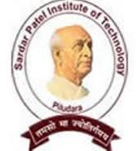
SARDAR PATEL INSTITUTE
of
TECHNOLOGY

Slide 2
E.C.E.
Elements of Civil Engineering
SUBJECT :
Transportation
engineering

Slide 3
Prepared by:
Patel Miral R.
Chauhan Yash B.
Akhja Prajesh J.
Kanjariya Suresh G.
Ghodasara Mayank C.
Movaliya Nirav G.
Rupareliya Karan H.
[130680102030]
[130680102004]
[130680102001]
[130680102015]
[130680102009]
[130680102018]
[130680102042]
Guided by :
KHUSHBU A. PATEL

Slide 4
Mode of Transportation
Mode of transport is a term used to distinguish substantially different ways to perform transport.
There are 4 mode of Transportation.
Road ways
Rail ways
Water ways
Air ways

Slide 5
Another Modes of Transportation are :
Pipelines
Elevators
Belt Conveyors
Cable Cars
Ropeways
Monorails
The efficiency of a transport mode can be judge in terms of following characteristics :
Speed
Safety
Adequacy
Frequency
Integration
Responsibilities
Cheapness
Fuel Efficiency
Employment Generation
Travel Time

Slide 6
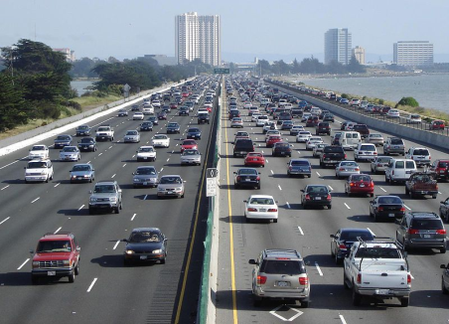
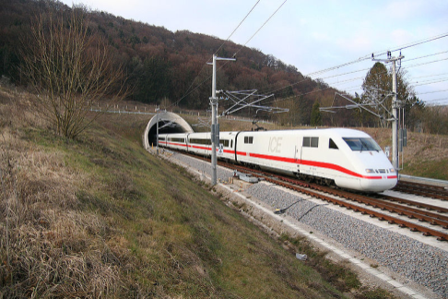
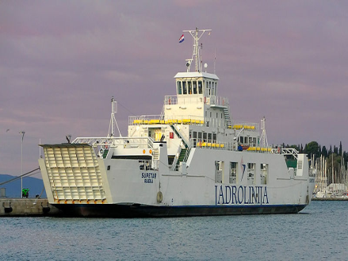
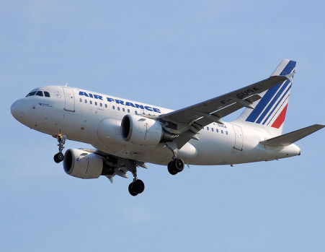
TYPES OF SURFACE
LAND
WATER
AIR

Slide 7
Land Surface Transportation:
A) ROAD -WAYS
The Roads are Classified as per VOLUME , TONNAGE of LOAD TRANSPORTED , LOCATION and FUNCTION.
One by One three 20 YEARs Road Development Programs were planned for INDIA .

Slide 8
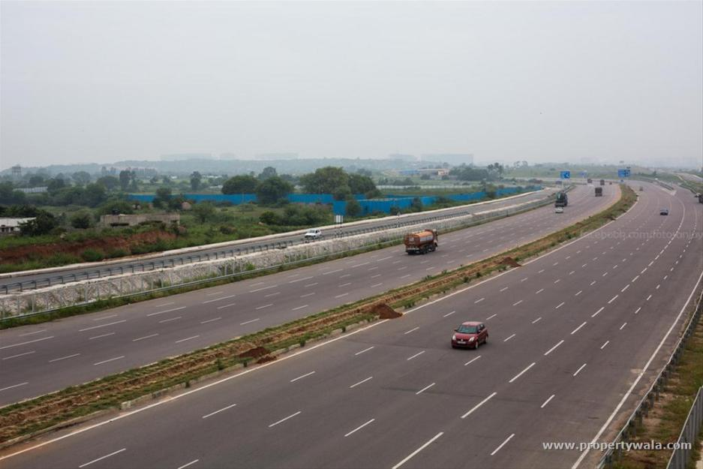
1) Nagpur Road Plan
[1943 – 63]
Classification Based on Roads Position in National Network of Road :
1) National highway (NH) :

Slide 9
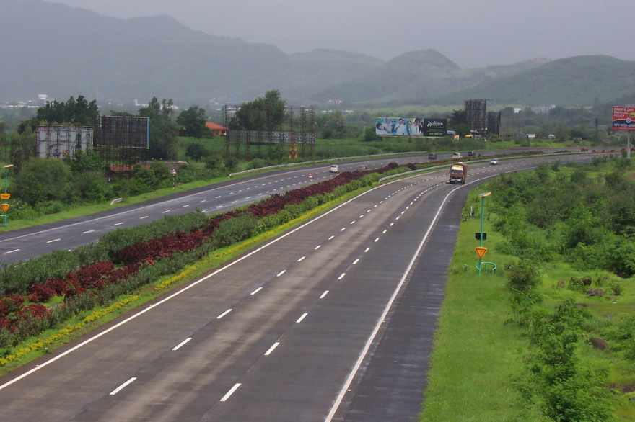
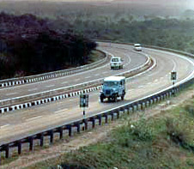
2) state highway (sH) :
SH is areal road of states , connecting to NATIONAL HIGHWAY of adjacent state , and Important Cities .
3) MAJOR DISTRICT ROAD (MDR) :
MDR is important road within district serving area of production and markets and connecting those with each other .

Slide 10
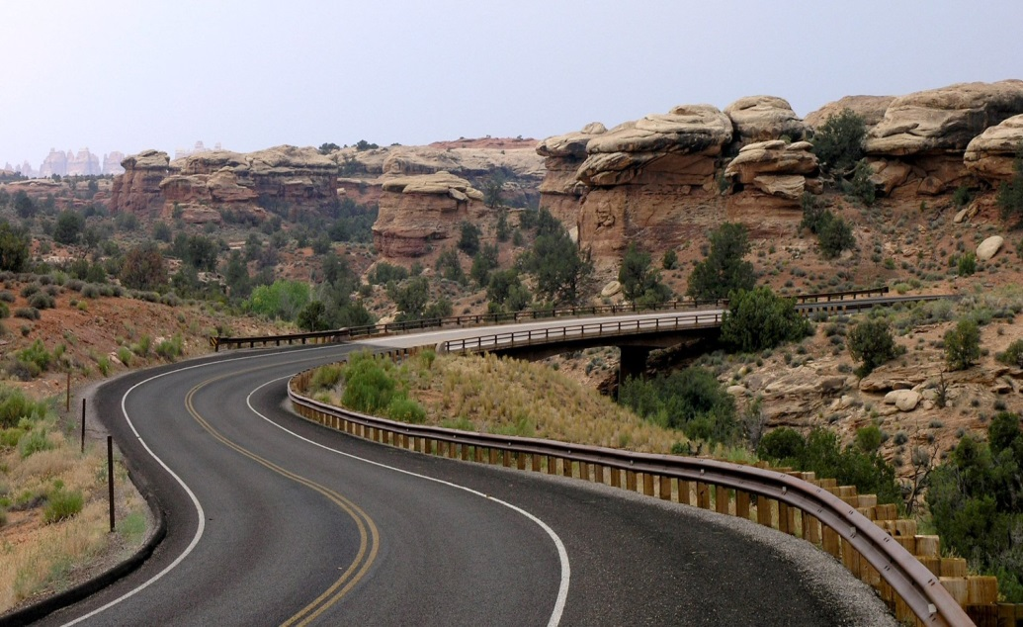
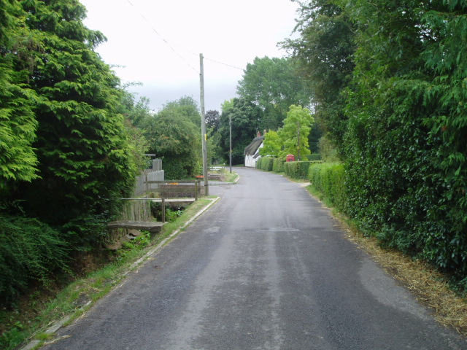
3) OTHER DISTRICT ROAD (ODR) :
ODR serving rural area of production and providing them with outlet to market centres , taluka , or other main roads .
4) Village ROAD (vR) :
VR road connecting villages or group of villages with each other to the nearest road of higher category.

Slide 11
2) Bombay Road Plan
[1961 – 81]
The Target Road length was completed earlier in 1961 hence IRC has declared 2nd 20 year road development plan commencing from 1961.
The area is divided into 3 parts :
Developed and agricultural area.
Semi-developed area.
Undeveloped and Uncultivated area

Slide 12
3) Lucknow Road Plan
[1981 – 2001]
As per This plan roads are classified for the purpose of transport planning into 3 categories
Primary system
Secondary system
Tertiary system
A) Expressway B) NH
A) SH B) MDR
A) ODR B) VR

Slide 13
Advantages and Disadvantages
Advantages:
Door to door service: road transport provides door to door service. It can collect and transport the goods from seller’s ware house and deliver it right at the door step of the buyer.
2. Economical for short distance: road transport is economical for short distance. Again, the loading and unloading charges are reduced due to direct transportation. 3. there is less overhead cost. The cost of maintains. Again, wages paid to drivers and others is less as compare to railways again the money spend on the maintenance . 4. the road transport offers more flexibility then that of railways. There are no fixed Scheduled. 5. road transport requires low investment. The vehicles such as trucks and tempos cost comparatively less as compare to trains, ships and aero planes.

Slide 14
Disadvantages:
1. Not suitable for bulky goods: road transport is not suitable to carry bulky and heavy goods, such as heavy machinery. It also not suitable to carry items of low grades because of the cost involves in transporting such good.
2. Uneconomical for long distance: the road transport is not economical for long distance. If the distance is more than 1000 Kms the vehicle reached to destination after three days. 3. Breakdowns and delays: because of poor conditions of Indian roads, there are often breakdowns. 4. Lack of informative in rates: there is no informative in transport rates. This is because; road transport is operated by private parties. 5. Limited protection to goods: road transport provides limited production to goods from rain, sun, dust and wind.

Slide 15
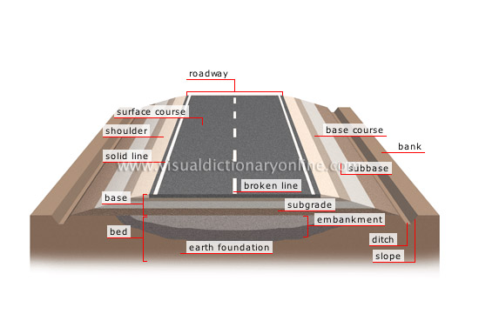
Road cross section :
In Embankment :

Slide 16
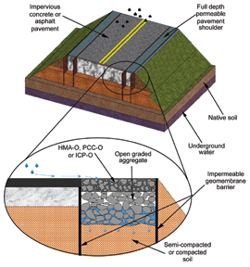
High way Pavement Section

Slide 17
B) RAIL -WAYS
Categories of railway :
Trunk Routes
Main Lines
Branch Lines
Types of Locomotives :
Diesel
Electric

Slide 18
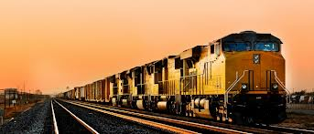
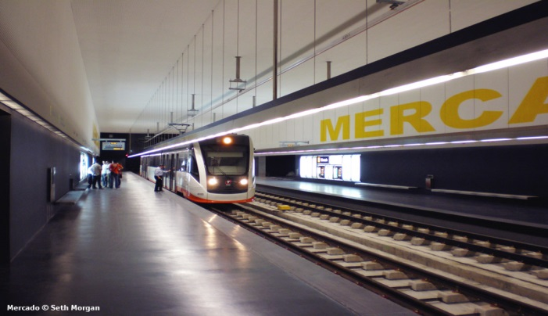
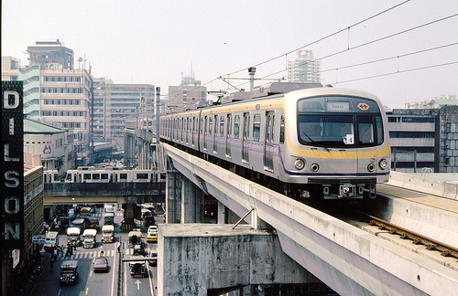
Types of railway :
SURFACE
UNDERGROUND
ELEVATED

Slide 19
Railway Track
Cross – section of Railway

Slide 20
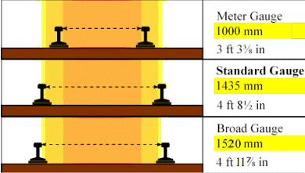
Types of Gauge :

Slide 21
Advantages and Disadvantages
Advantages:
It facilitate long distance travel and transport of bulky goods which are not easily transported through motor vehicles.
ii. It is a quick and more regular form of transport because it helps in the transportation of goods with speed and certainty.
iii. It helps in the industrialization process of a country by easy transportation of coal and raw-materials at a cheaper rate.
iv. It helps in the quick movement of goods from one place to another at the time of emergencies like famines and scarcity.
v. It encourages mobility of labor ad thereby provides a great scope for employment.
vi. Railway is the safest form of transport. The chances of accidents and breakdown of railways are minimum as compared to other modes of transport.

Slide 22
The railway requires a large investment of capital. The cost of construction, maintenance and overhead expenses are very high as compared to other modes of transport. Moreover, the investments are specific and immobile.
ii. Another disadvantages of railway transport is its inflexibility. It routes and timings cannot be adjusted to individual requirements.
iii. Rail transport cannot provide door to door service as it is tied to a particular track. Intermediate loading or unloading involves greater cost, more wear and tear and wastage of time.
iv. As railways require huge capital outlay, they may give rise to monopolies and work against public interest at large.
v. Railway transport is unsuitable and uneconomical for short distances and small traffic of goods.
vi. It involves much time and labour in booking and taking delivery of goods through railways ascompared to motor transport.

Slide 23
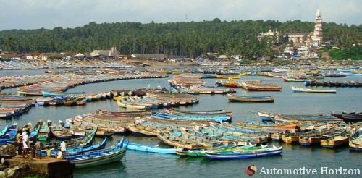
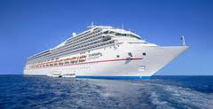
Water Surface Transportation:
It is divided into following 2 categories
Inland Water Transportation
Ocean Water Transportation

Slide 24
Advantages and Disadvantages
Advantages:
Cheapest traffic means
Most important in security of nation
Plays important role in international trade.
Possesses high load carrying capacity.
Requires cheap motor powers than for airplanes.
Does not require any special infrastructure like roads, and airports.
Brings many countries together.
Disadvantages:
Slow in speed
More chances of attack on boat sailing through
Only can be used when sufficient water is available.
In deep sea if boat gets in to storm, it becomes difficult to rescue.
In waterfalls having much drafts ,water transportation does not works.
Special maintenance for water tightness of boat is required.

Slide 25
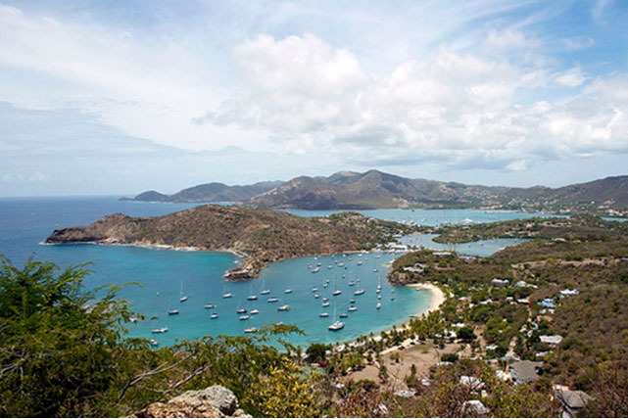
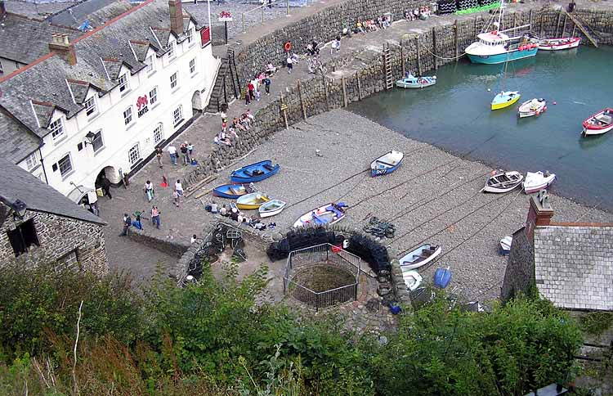
Harbour
harbor or haven, is a body of water where ships, boats, and barges can seek shelter from stormy weather, or else are stored for future use.
Harbors can be natural or artificial.
Natural Harbour
Artificial Harbour

Slide 26
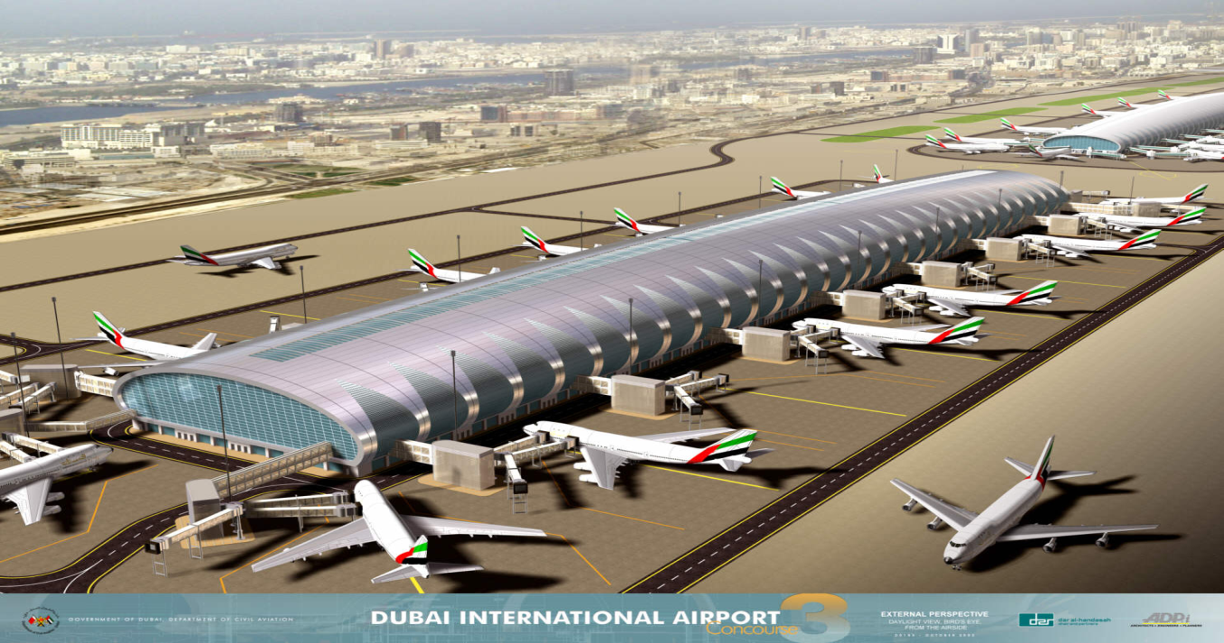
Air Surface Transportation:
Aviation Deals With AIRWAYS. The movement people and goods by Aero planes , aircraft , Helicopters ETC.
Types of Airport :
1) International Airports :-

Slide 27
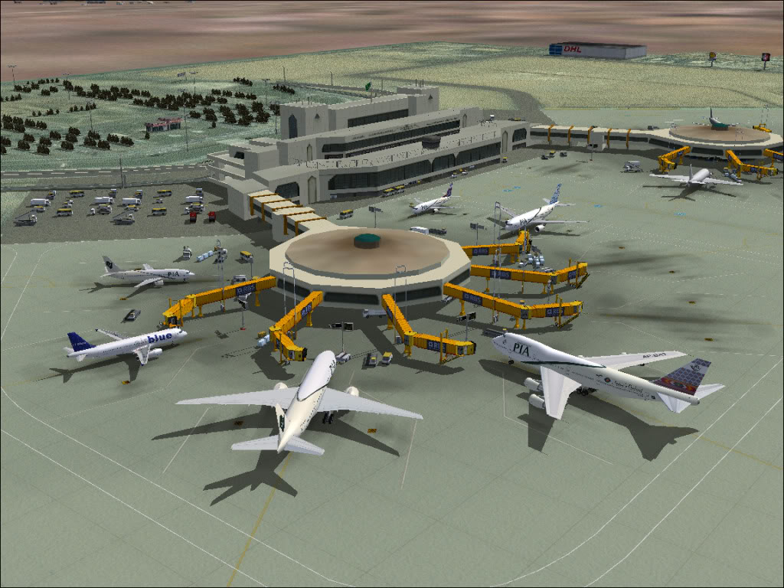
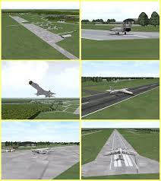
2) Domestic Airports :-
3) Military Airports :-

Slide 28
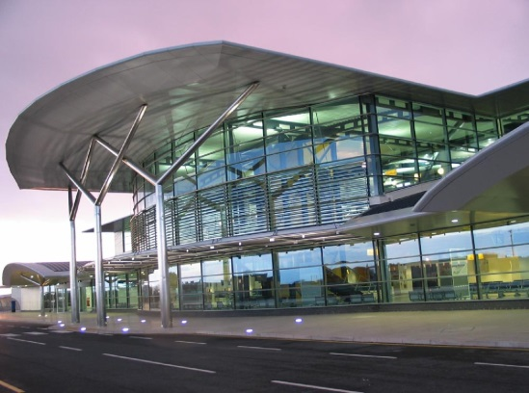
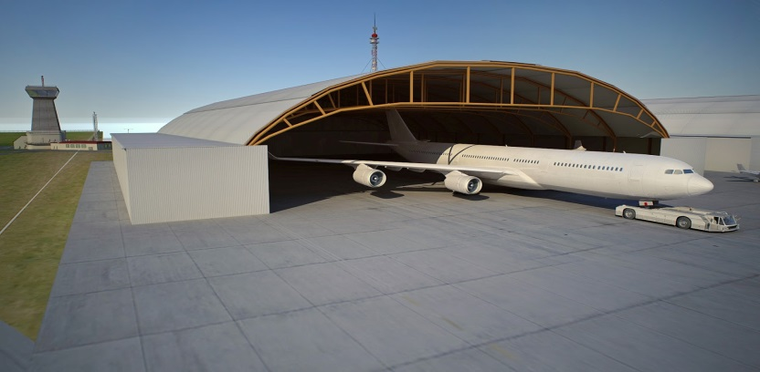
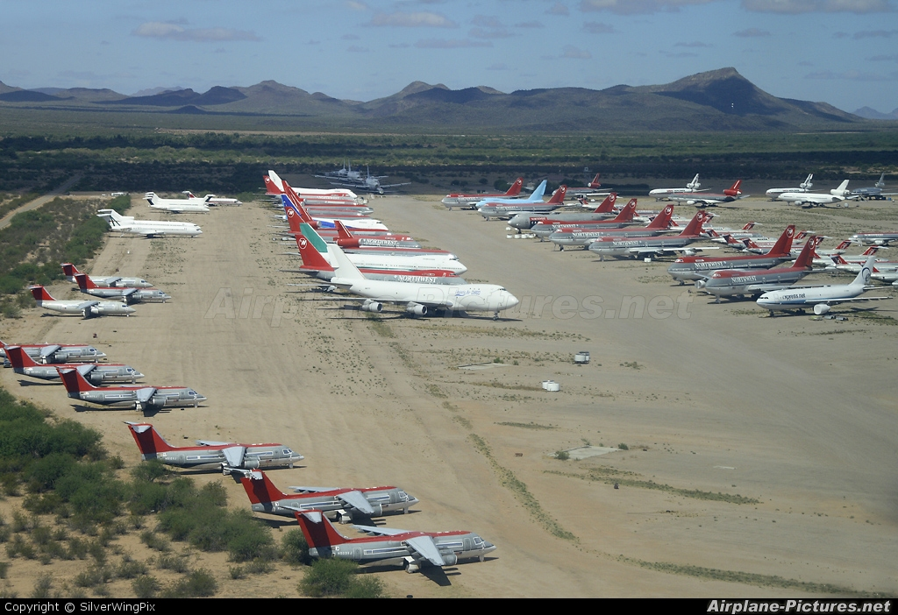
Components of Airport
There are 8 components :
1. Terminal :
2. Hanger :
3. apron

Slide 29
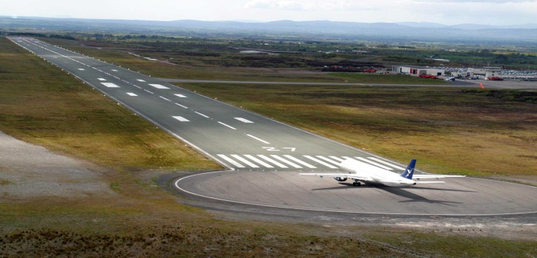
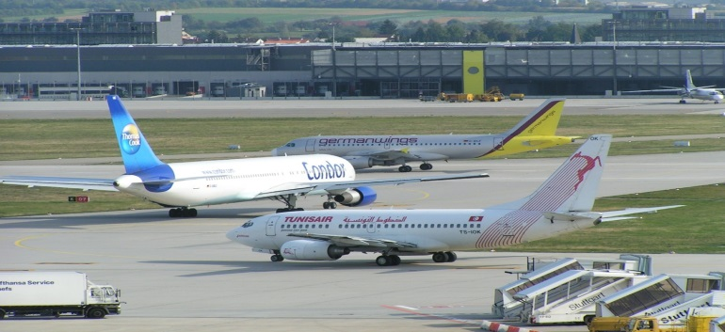
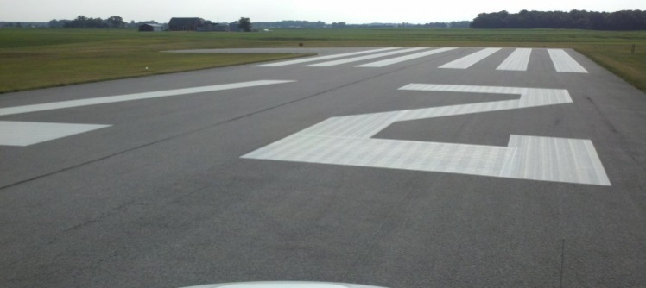
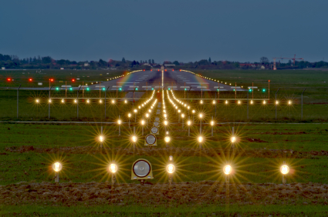
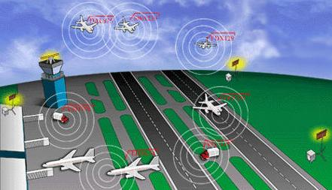
4. runway :
5. Taxiway :
6. Pavement
marking :
7. lighting :
8. Radar system:

Slide 30
Advantages and Disadvantages
Advantages:
1. Fastest means of Transport : Air transport operates at a very high speed. The high speed makes the air transport the fastest of all the other forms of transport. 2. Suitability: Air transport is suitable to carry passengers who want lot of comfort and convenience. The passengers can save lot of time. Light and valuable goods like diamonds, gems, etc. 3. Vital during emergencies: Air transport is very vital during emergencies. When there are floods, earthquakes, etc. foods, medicine and other requirements can be supplied to victims with the help of helicopters. 4. Efficient service: Air transport, especially, the international airlines provide highly efficient services to its customers.

Slide 31
Disadvantages:
1. Huge investment: Air transport requires huge investment. A motor vehicle can cost a lakhs of rupees which the person can afford to buy, but an aero plane costs crores of rupees. 2. Limited carrying capacity: The air transport has a limited carrying capacity as compared to Water and Railway Transport. This is because; the space available in the aero plane is limited. 3. Heavy maintenance cost: Air transport requires heavy maintenance cost. There is a constant need to monitor the maintenance of the vehicle. This is because the aero planes carry important or rich passengers and also valuable cargo.
4. High overhead cost: The air transport requires high overhead cost. This is because the aero planes and other vehicles use pure fuel , crew and other staff are very high.

Slide 32
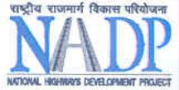
BOT project for Highways
All of the following different parties could be involved in any BOT project :
The host government: Normally, the government is the initiator of the infrastructure project and decides if the BOT model is appropriate to meet its needs. In addition, the political and economic circumstances are main factors for this decision. The government provides normally support for the project in some form.
Lending banks: Most BOT project are funded to a big extent by commercial debt. The bank will be expected to finance the project on “non-recourse” basis meaning.
Other lenders: The special purpose entity might have other lenders such as national or regional development banks.
Parties to the project contracts: Because the special purpose entity has only limited workforce, it will subcontract a third party to perform its obligations under the concession agreement. Additionally, it has to assure that it has adequate supply contracts in place for the supply of raw materials and other resources necessary for the project

Slide 33
BOOT project for Highways
A BOOT structure differs from BOT in that the private entity owns the works.
During the concession period the private company owns and operates the facility with the prime goal to recover the costs of investment and maintenance while trying to achieve higher margin on project.
Some advantages of BOOT projects are:
Encourage private investment
Inject new foreign capital to the country
Transfer of technology and know-how
Completing project within time frame and planned budget.
BOOT operators are experienced with management and operation of infrastructure assets and bring these skills to the scheme.

Slide 34
Elements of Traffic Engineering
definition :
Traffic engineering is a branch of civil engineering that uses engineering techniques to achieve the safe and efficient movement of people and goods on roadways.
Traffic Characteristics
Road User Characteristics
Vehicular Characteristics

Slide 35
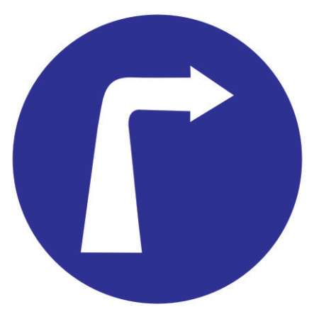
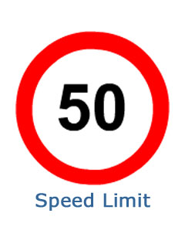
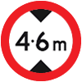
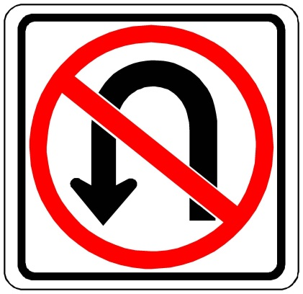
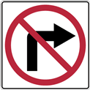
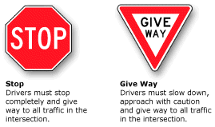
Traffic Signs :
A.) Regulatory Signs :

Slide 36
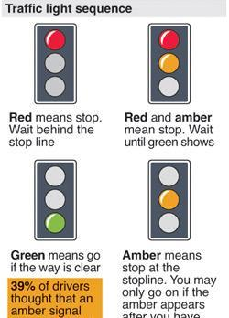
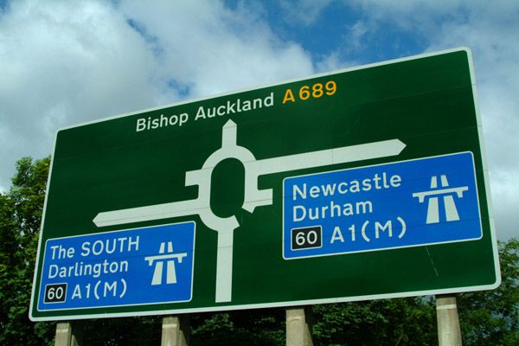
Informatory Signs :
1.) Direction and Identification Signs :
2.) Traffic Signals :

Slide 37
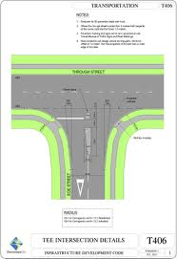
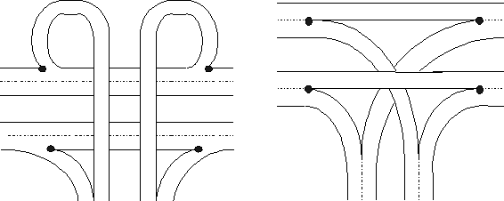
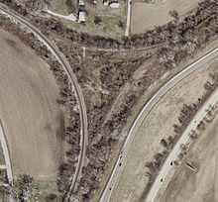
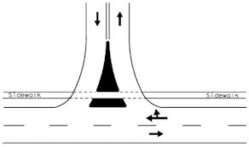
Intersection
TEE intersection :
WYE intersection :
CROSS intersection :

Slide 38
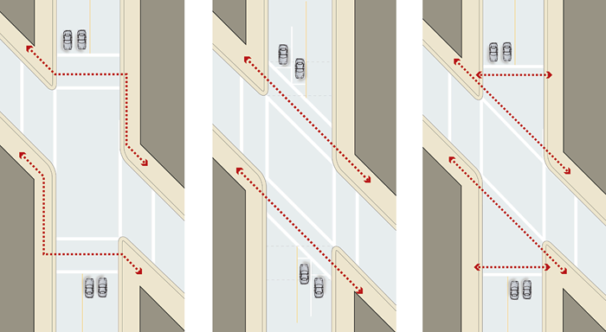
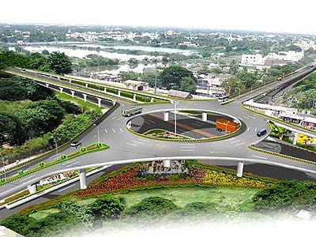
SKEWED intersection :
ROTERY intersection :

Slide 39
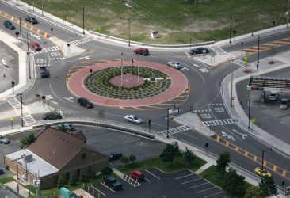
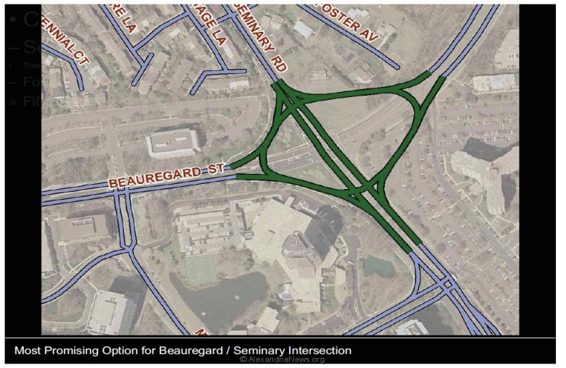
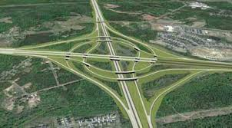
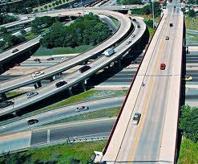
Type of ROTERY INTERSECTION :
Circular
Elliptical
Turbine
Tangent
…………..

